Slide 1


Slide 2
Digitization and 3d modelling of a mine plan

Slide 3
What is digitization, 3d model and 3d modelling?
Digitization is conversion of analog information into digital information.
3D models represent a 3D object using a collection of points in 3D space, connected by various geometric entities such as triangles, lines, curved surfaces, etc. Being a collection of data ( points and other information), 3D models can be created by hand, algorithmically (procedural modelling), or by computer aided methods.
3D modelling is the procedure of developing a 3D model using specialized software. It is a process of creating a wireframe model that represents a three dimensional object.

Slide 4
Objective and Scope of project
Objective:- To convert a Mine Plan into a 3d Model.
Scope:-
Eliminate drilling in non-mineralized (or poor grade) area, therefore, saving in drilling cost.
Reserve estimation with a view to optimize and conserve mineral resources.
Multi elemental grade calculation, grade control and prediction.
Pit design as per the statutory requirement .
Calculation of correct volume of material removed from an area between certain periods as required

Slide 5
Software used for digitization and 3d modeling of the plan:-
AutoCAD
Surpac
Minex
Vulcan

Slide 6
Design of Experiment
MINE PLAN
SCANNING OF PLAN
IMPORTING SCANNED PLAN INTO AUTOCAD AND DIGITIZATION OF PLAN IN AUTOCAD
IMPORTING THE DIGITIZED PLAN INTO SURPAC AND GENERATING A 3D MODEL

Slide 7
Lab work carried out:-
1. DETAILS OF PLAN:
Project: GHOGHRI COAL BLOCK
Seam: 1C seam
Date of plan: jan,08
Scale 1:8000

Slide 8
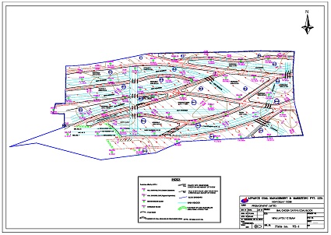
2. SCANNED IMAGE OF PLAN

Slide 9
3. DIGITIZATION OF SCANNED PLAN IN AUTOCAD
Importing of plan into AutoCAD
Feed the values of:
Scale 1:8000
Rotation 0⁰
Coordinate of the origin
Tracing of each object of plan with the tools of AutoCAD. Such as circle, line, polyline ,etc.
This will generate a digitized map. Save this in .dwg format.
After saving the file the extension is changed into .str

Slide 10
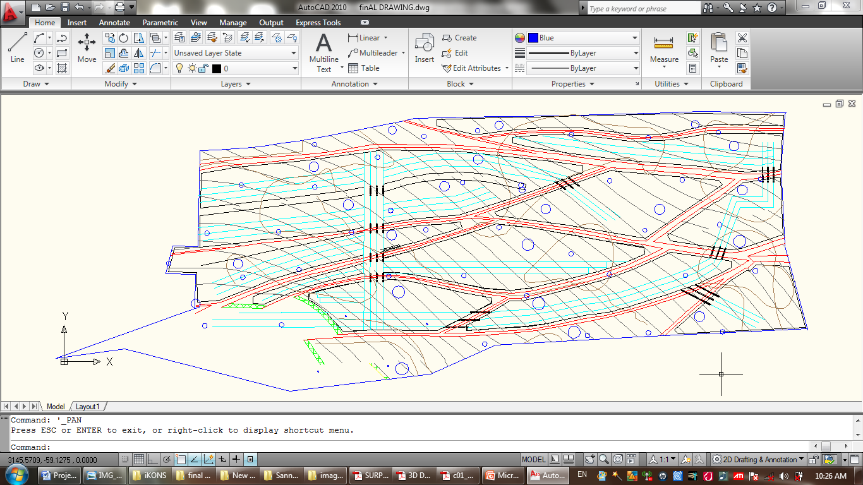
DIGITIZED MAP IN AUTOCAD

Slide 11
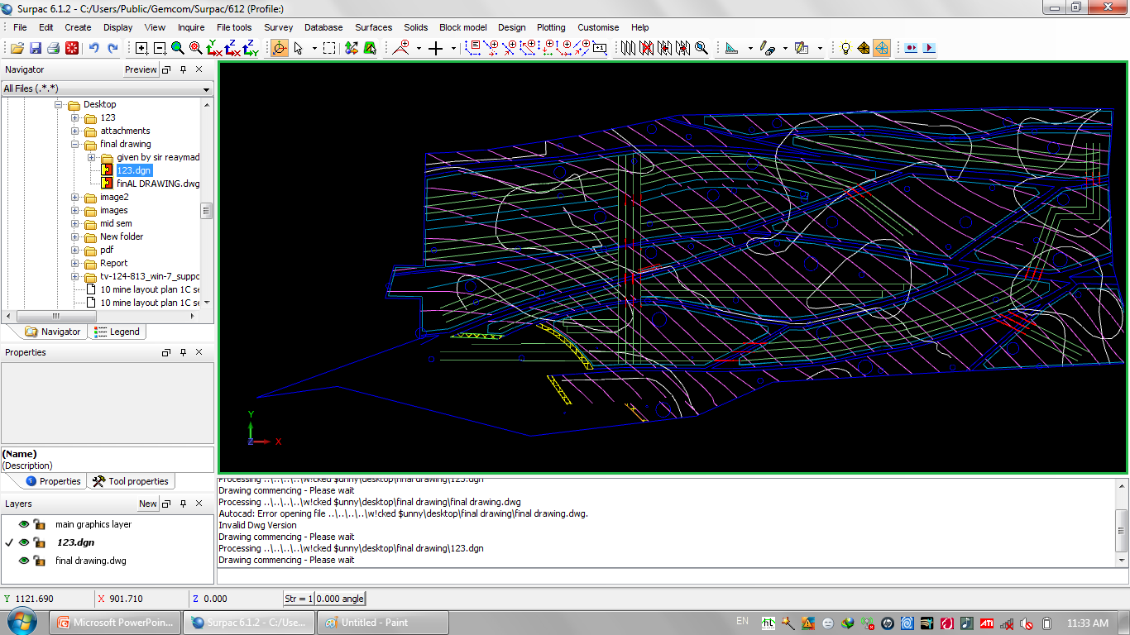
4. 3-D MODELLING OF DIGITIZED MAP
Importing digitized plan in surpac.

Slide 12
Parts and format of imported file
The file imported in surpac is a string file(.str).
A string is a sequence of three dimensional coordinates delineating some physical feature.
If more than one string in there in the file then the string is divided into no. of segments.
With the help of the move segment/string option under edit menu, different segement of the file have been set to different RL to make a 3d model.

Slide 13
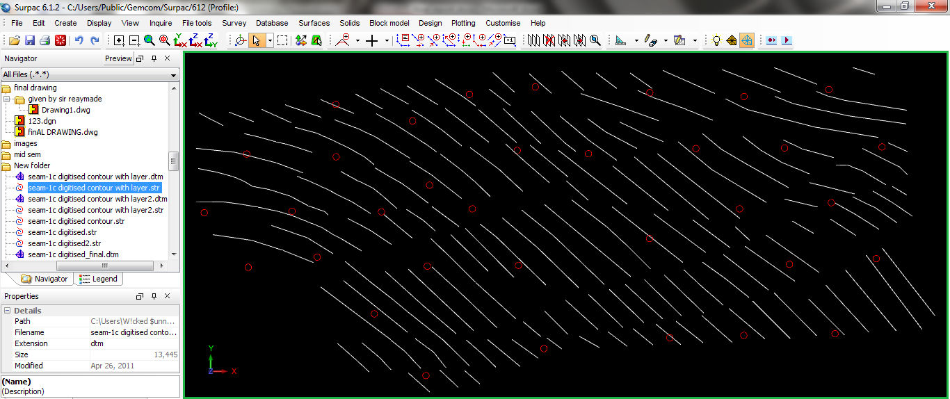
Generating the string file of contour of u/g working area

Slide 14
Making a digital terrain model
All the segments of the similar properties are triangulated and joined together to form a surface.
The digitized map is divided into two layer to make the work easy.
Layer 1: contains underground surface of mine.
Layer2: contains other features of mine like shaft, incline, galleries,etc.

Slide 15
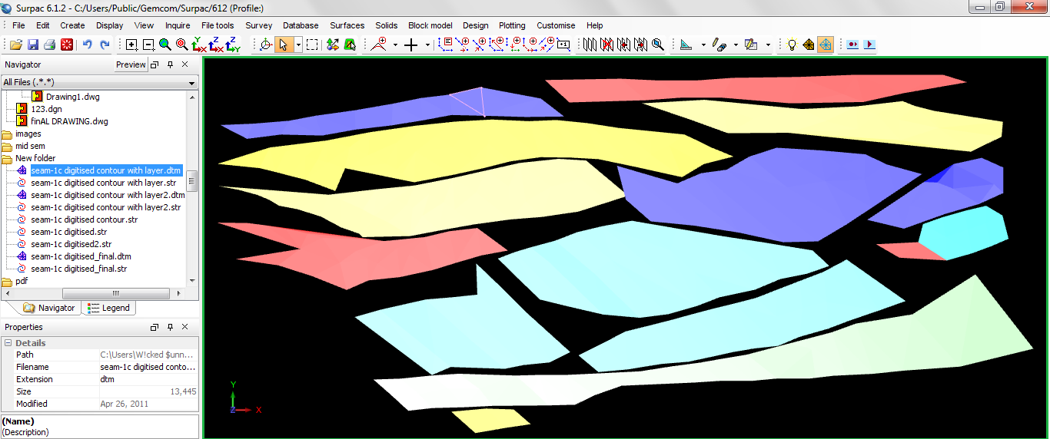
Creating digital terrain model of contour of u/g working area.

Slide 16
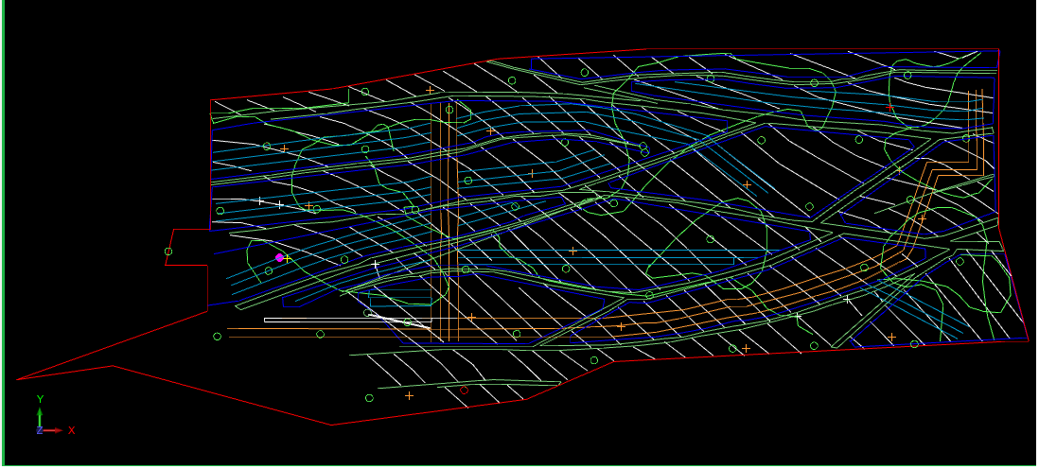
Similarly Creating the string file of layer 2

Slide 17
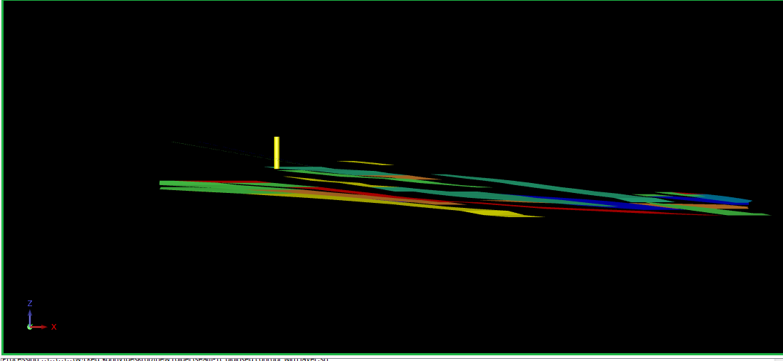
Digital terrain model of layer 2

Slide 18
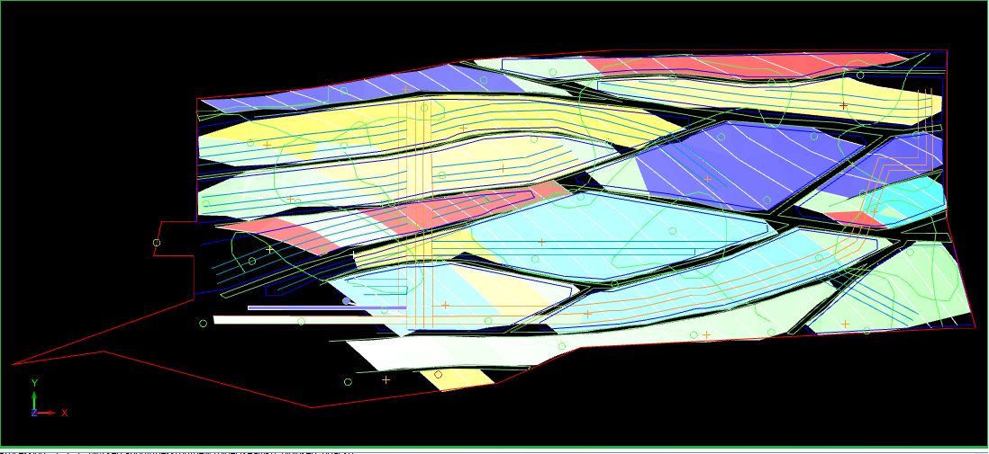
Overlapping of string file on digital terrain model of all layers will generate the 3-D model of map.

Slide 19
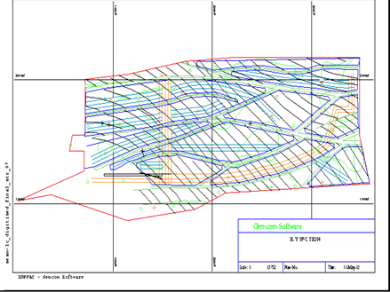
Analysis of investigation
Different sections of the map will be generated from autoplot option. X-Y Section

Slide 20
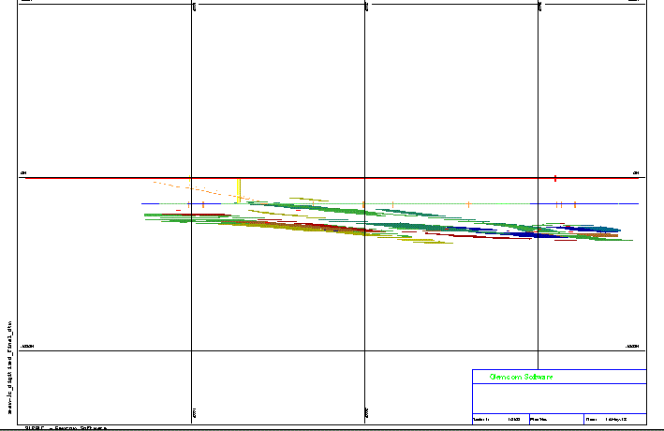
X-Z Section of Map

Slide 21
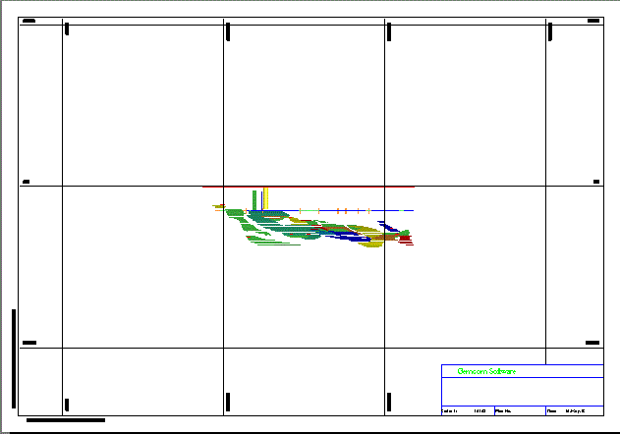
The section of map generated along Z-Y plane.

Slide 22
CONCLUSION
After completing the project it was concluded that with digitization and 3-D modeling it was very easy to generate different plans and sections of the mine. This will be very help full in mine design and planning. And teaching the employees about the mine and its different working area. 3d Models can also be used for teaching the student of Mining for better understanding of different underground mining methods.

Slide 23
Other Advantages of Digitization and 3d Modeling of mine plan:-
Digital Maps and plan are easy to store.
As Surpac is compatible with most of the Total stations available in the market, the time required for volume calculation is reduced to such an extent that it may go concurrent with mining.
Calculation of correct volume of material removed from an area between certain periods as required. This is especially useful where, huge overburden is to be removed or where, mining is by a contractor. This increases data integrity beyond doubt.
Up gradation of the plan is very easy.
Very Most accurate then drawing.
3d model will give a better understanding of the project.
All the sections of the plan will automatically generate.
Easy understanding of the ore body will make the planning very economic and time saving.
Easy reserve and remnant calculations

Slide 24
FUTURE SCOPE OF WORK
With the help of 3-D model it will be very easy to calculate ore reserve estimation by the options available in surpac under design menu.

Slide 25
Methodology to calculate ore reserve:
Basic data and methodology
Survey data
geological database
Assay BH id, samp. no., from, to & assay
Geology BH id, sample no.
Survey to BH id, to depth,dip, azimuth
Collar BH id, NEZ, Tot. depth
Section Preparation
Stitching of section- ORE Body
Block Modelling and filling of attributes
Slicing as required
Pit designing and Mineable reserves

Slide 26
REFERENCES
Sham Tickoo, (2012); Exploring AutoCAD Map 3D, 2012, Published by CADCIM Technologies, Page 1-2 to 1-16.
Rowdy Bristol, Phil Jackson, James Willoughby, (Aug-2007); Introduction to surpac 6.0, Surpac Minex Group, Page 18-27.
Alparslan Turanboy, M. Kemal Gokay, Erkan Ulker, (Feb. 2008); An approach to geometrical modelling of slope curves and discontinuities, Simulation Modelling Practice and Theory 16 (2008), Page 445-461.
Asst. Prof. B. S. Chaudhary, SURPAC- A COMPUTER SOFTWARE FOR BETTER MANAGEMENT OF MINE SURVEY AND GEOLOGY INFORMATION, Lecture-1, Page 1-4, 6-12.
Asst. Prof. B. S. Chaudhary, SURPAC- A COMPUTER SOFTWARE FOR BETTER MANAGEMENT OF MINE SURVEY AND GEOLOGY INFORMATION, Lecture-2, Page 1-8.
www.gemcomsoftware.com

Slide 27
Thank You

